Slide 1
Using SculptPrint as a DFM Tool in SolidWorks
Dr. Cassandra Telenko
Ruoyu Song
Aniruddh Marellapudi

Slide 2
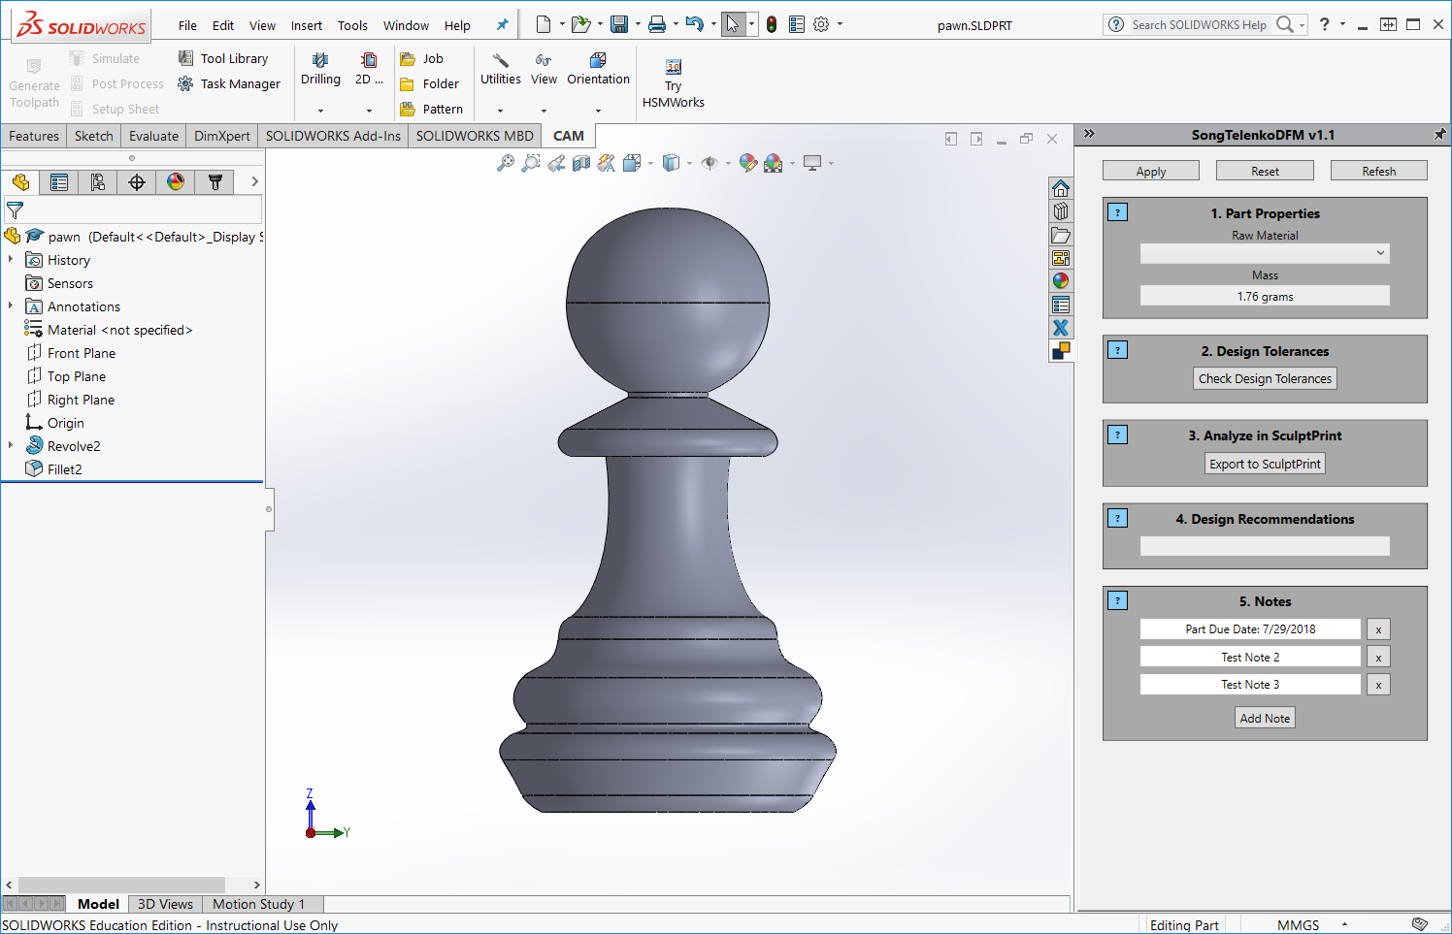

Slide 3
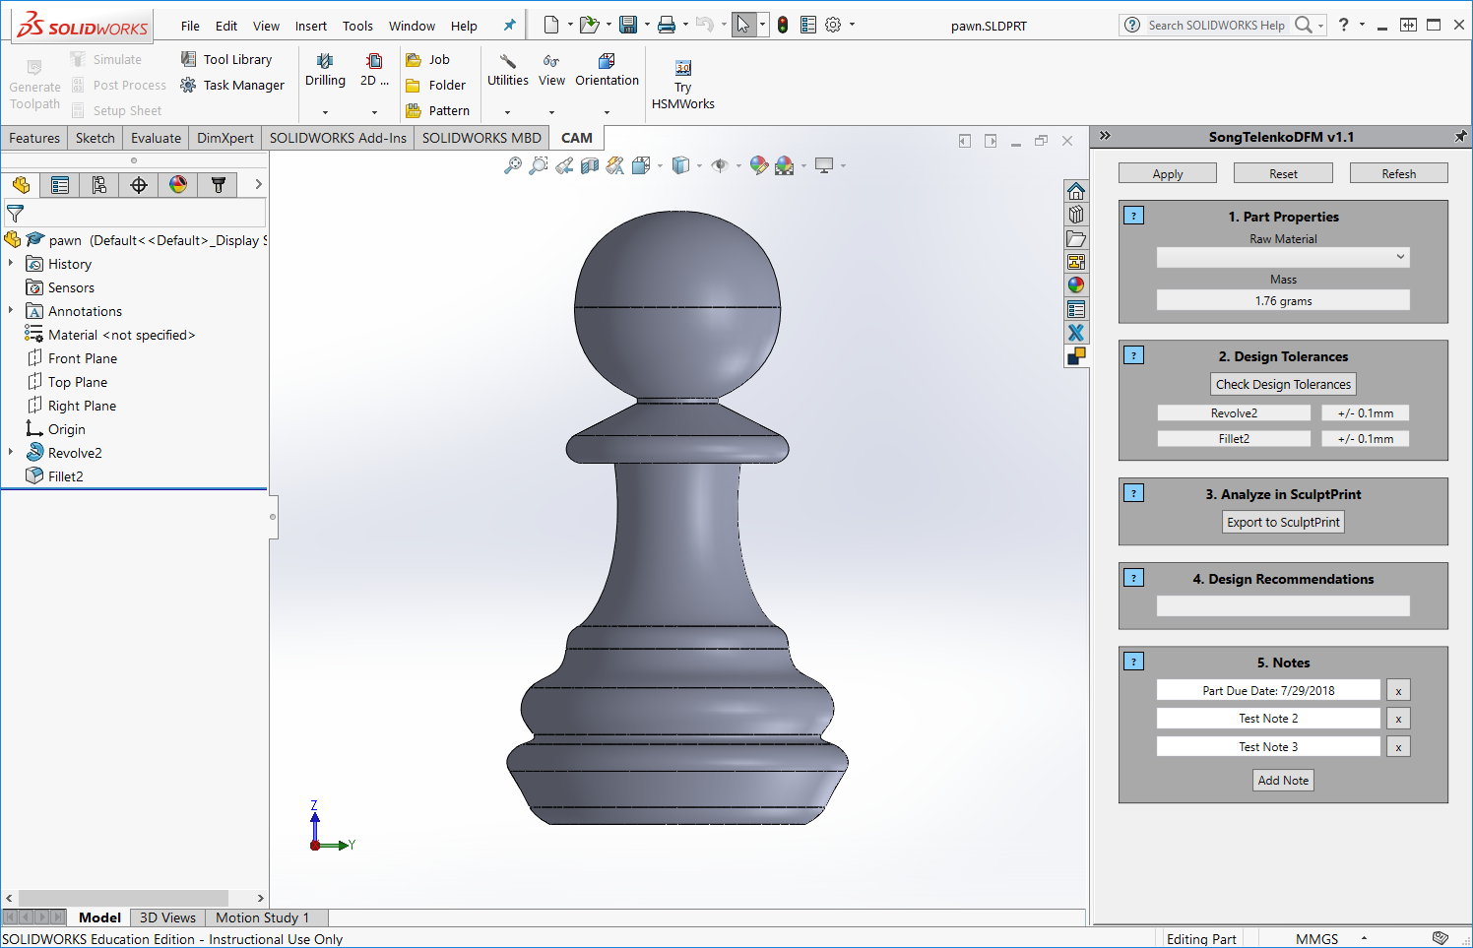

Slide 4
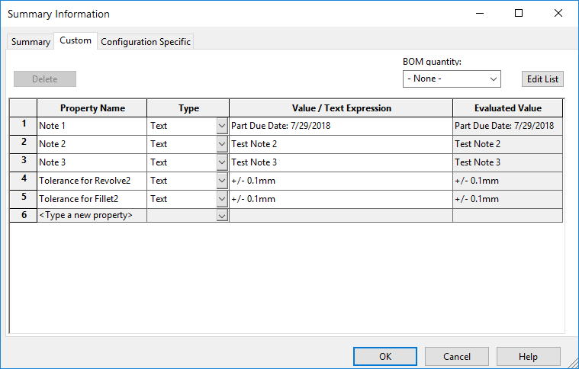

Slide 5
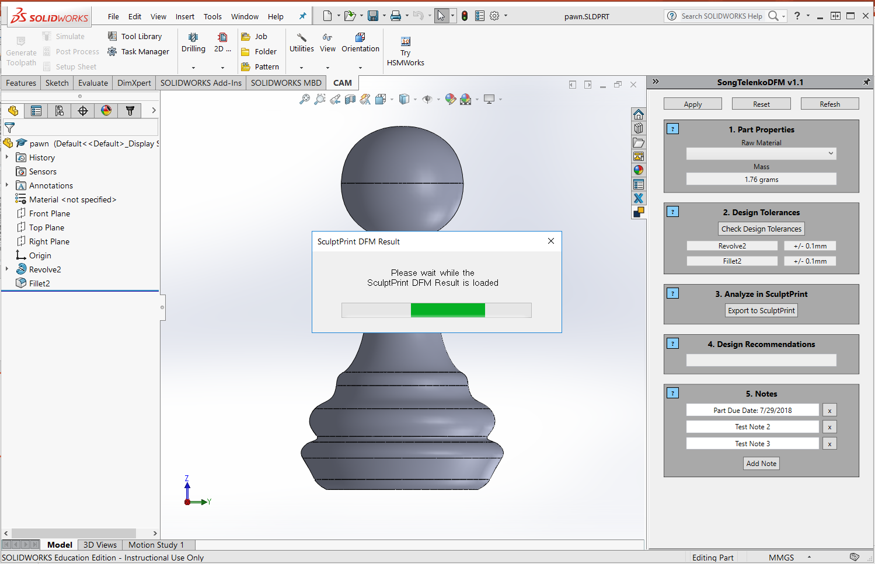

Slide 6
